Slide 1
6.3 Artificial intelligence
Understand what is meant by artificial • intelligence (AI)
Describe the main characteristics of AI as the collection of data and the rules for using that data, the ability to reason, and can include the ability to learn and adapt
Explain the basic operation and components of AI • systems to simulate intelligent behaviour
AI is a branch of computer science dealing with the simulation of intelligent behaviours by computers
Limited to:
– expert systems
– machine learning

Slide 2
Today
Understand what is meant by artificial • intelligence (AI)
Describe the main characteristics of AI as the collection of data and the rules for using that data, the ability to reason, and can include the ability to learn and adapt
Explain the basic operation and components of AI • systems to simulate intelligent behaviour
AI is a branch of computer science dealing with the simulation of intelligent behaviours by computers
Limited to:
– expert systems
– machine learning
Understand: What is meant by AI
Able: To explain how AI works
Answer: What is an expert system and machine learning

Slide 3
Note
For IGCSE, Cambridge just lumps all different branches of AI as one big thing, but really AI is split into 3 parts.
Artificial Intelligence (AI)
Machine Learning (ML)
Deep Learning (DL)
We will cover the basics of all 3 and we will call them their proper names, but in your exam they may just call it all AI
They do this because they want us to know that:
Artificial Intelligence (AI) = Part of Computer Science that deals with the simulation of intelligent behaviours by computers

Slide 4
AI vs ML vs DL
Three terms:
1. Artificial Intelligence (AI)
2. Machine Learning (ML)
3. Deep Learning (DL)
Which of these statements describes AI, ML and DL
If you, a human, program a machine to think like a human
The machine can learn new things without it being programmed to specifically learn these new things, it learns by itself.
Uses a neural network to think and behave like a human.

Slide 5
ANSWERS
1. Artificial Intelligence (AI)
2. Machine Learning (ML)
3. Deep Learning (DL)
Which of these statements describes AI, ML and DL
AI = If you, a human, program a machine to think like a human
ML = The machine can learn new things without it being programmed to specifically learn these new things, it learns by itself.
DL = Uses a neural network to think and behave like a human.

Slide 6
Is everything AI?
But wait, if we say that ML means a computer can learn by itself, doesn’t a human have to initially tell the computer that it CAN learn by itself, doesn’t a human have to make a first program to tell the computer HOW to learn and then the computer can learn by itself.
Yes, a human first needs to make a learning program.
So if a human needs to make a program first, isn’t Machine Learning just part of AI?
Yes it is. But we don’t say “part of” we say subset.
AI can include everything and part of it is ML and part of ML is DL or is we say it correctly:
DL is a subset of ML, ML is a subset of AI
AI
ML
DL

Slide 7
Types of AI
So if ML and DL are a subset of AI, it means everything is AI right?? Yep. This is correct.
But we split it up into ML and DL as these are more advanced versions.
There are 3 versions that AI and subsets of AI can fall into:
Narrow AI
General AI
Strong AI

Slide 8
Narrow, General, Strong
Narrow AI = When a machine is better than a human in one task
General AI = When a machine is similar to a human in many tasks
Strong AI = When a machine is better than a human in many tasks

Slide 9
Machine Learning
Machine learning is when a machine can learn from past experiences.
But this is a lie
What Machine learning actually does is build a profile and then guesses
It should really be called Machine Guessing, but Machine Learning sounds more advanced.

Slide 10

Real Example
This is my music player app on my phone. (Amazon Music)
It uses Machine Learning to know what songs to play.
When I like a song, I press the thumbs-up button
When I hate a song, I press the thumbs-down button

Slide 11
Profile
Most of the time I listen to music when I am in the gym.
So the app builds a profile of me of songs I tend to like
Most of the time I like fast songs with a female singer
Fast
Slow
Male
Female

Slide 12




Past Experiences
So the machine now knows that I prefer fast songs with a female singer, so it plays me songs that fit into this category. It doesn’t know if I like them, but it guesses that I will like them based from my past experience
But sometimes it will play Linkin Park, which I also like, but it has a male singer, so how does it know to play Linkin Park?

Slide 13
Lie
I lied, I said it plays songs “based from my past experience” but this is a lie, because its not just MY experiences but from everyone else who uses the app.
It knows I like Avril Lavigne, and then it looks at all the other people who like Avril Lavigne. Out of all of those people, 80% of them also liked Linkin Park, so the machines GUESSES that I would also like Linkin Park.
But the guess is not random, its based on the past inputs of everyone who used the app. The more data it has the better the guess it provides

Slide 14
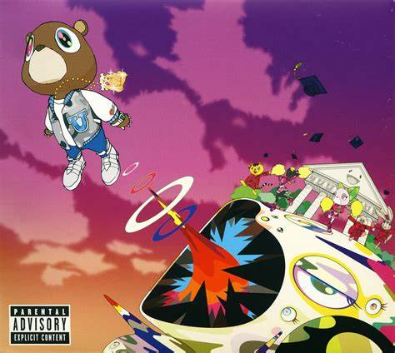
Problem
A problem with this method is I also like Kanye West. But this is slower songs with a male voice.
But using my profile, Machine Learning is unlikely to pick this.
So you have to search for it manually, press “thumbs-up” and then allow ML to adjust your profile

Slide 15
Remember
For IGCSE exam, you may not see the term Machine Learning, they may just call it Artificial Intelligence (AI).
But they mean the same thing.
Machine guessing
The two parts of AI are:
Expert Systems
Machine Learning
We done machine learning, but what is an expert system?

Slide 16
What is an expert system?
Expert system = Software that pretends to be human
But not any dumb human….. It pretends to be an expert
Its used so if you are a dumb humans you can get the same knowledge an expert has without having to study or work in that area.

Slide 17
Example
Pretend you are dying
You want to know what is wrong with you
You can:
Pray and hope you get better (but this doesn’t tell you why you are sick)
Go to the doctors / hospital (maybe you dislike them, or expensive, or you have a stupid doctor, or too far away)
Study to be a doctor (but maybe you will die before you get to know everything)
Use an expert system (It is only software)
http://symptoms.webmd.com/default.htm#introView

Slide 18
WebMD
NOT a doctor
It is just software that pretends to be an expert human
It is an expert system
Has 3 parts
Knowledge base This is where it gets information from real human experts and stores it in a database
Inference Engine Like a search engine. Takes the dumb human request and matches it with the knowledge base
User Interface What the dumb human sees. Lets you ask (query) data and receive advice.

Slide 19
Terms
Expert System : Software designed to replicate human experts
Knowledge base : Collection of facts and rules provided by human experts
Inference engine : Matches the information from the knowledge base to the user query
User Interface : Allows a user to ask a question (query) and get an answer / advice

Slide 20
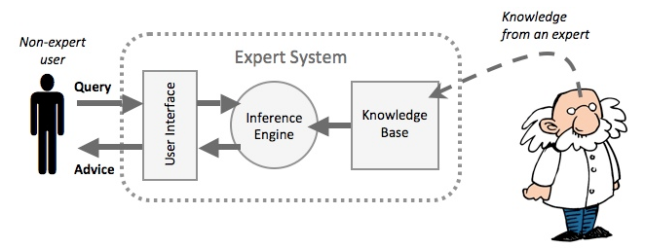
What are the boxes hiding?
6
7
1
3
4
5
2

Slide 21
Where?
Medical
- Diagnosis
Strategy Games
- Chess
Financial
- Performance of stock and shares / what to buy
Identify items
- Plants, animals, rocks. The KB will have data of the characteristics so you can identify a new species
Drilling
- Identify good sites to oil drill / water drill
Cars
-Identify car engine problems

Slide 22
+ / -
+ No need to speak to a human / Solve your own problems
+ Many experts can have their knowledge in the knowledge base
+ Easy to access
Cannot adapt to new circumstances (Tell Ainur watermelon story)
If user makes mistakes in their query then their advice could be very wrong
No common sense

Slide 23
Note for Amar
Amar, this is Amar typing.
The Cambridge syllabus says we now start programming (Section 7) but I want you to do Databases (Section 9) and Boolean Logic (Section 10) before you start programming.
Don’t finish yet.
Do :
9 - Databases and
10 – Boolean Logic now

Slide 24
